Slide 1
PRESENTATION A part 1
What is a stateless protocol?
What is a protocol in computer terms?
What is a request? What is its structure?
What is a response? What is its structure?
What is the HTTP method used when accessing a URL?
What is the role of headers in requests? And in responses?
What is the difference between HTTP and URL?
That a request is well formulated implies that you will get a correct answer?

Slide 2
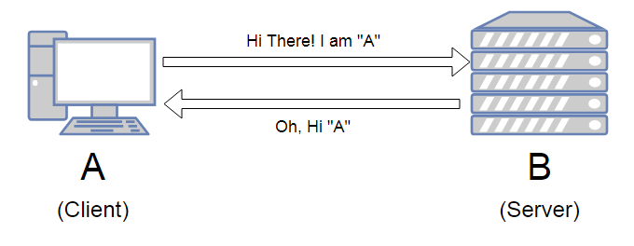
What is a stateless protocol?
A stateless protocol is a protocol in which each particular communication is handled as an independent event, unrelated to other similar communications. An example for such a protocol would be HTTP protocol. The client make a request to the server but isn’t dependent on the server response to proceed a connection. Unlike, FTP protocol in which both the client and the server have to be connected and transfer information among each other.

Slide 3
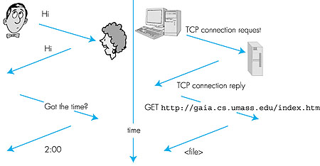
What is a protocol?
A protocol, in computer science, a set of rules or procedures for transmitting data between electronic devices, such as computers. In order for computers to exchange information, there must be a preexisting agreement as to how the information will be structured and how each side will send and receive it.

Slide 4
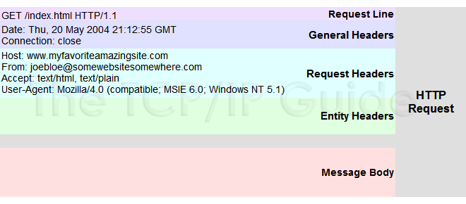
What is a request?
A request is part of a client-server protocol in which the client is asking for some information or data from the server. Web clients and servers communicate by using a request/response protocol called HTTP. A complete HTTP request consist of the request-line, the message-headers, and the entity-body. Between the message-headers and entity-body is an empty line contains only carriage returns and line feeds.

Slide 5
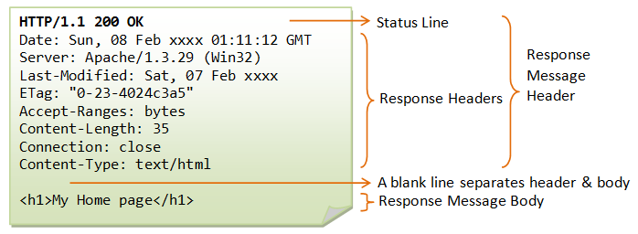
What is a response?
A response is part of a client-server protocol in which the server is sending back information or data from to the client upon request. An HTTP response contains:
A status line and code.
A series of HTTP headers, or header fields.
A message body, which is usually needed.

Slide 6
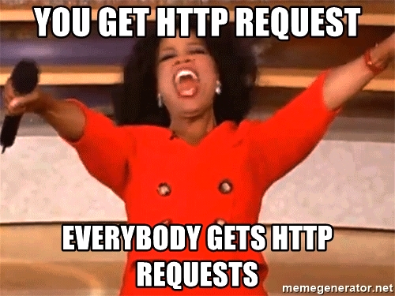
What is the HTTP method used when accessing a URL?
As our machine is the client trying to retrieve information from a remote server in a form of a website such as google or facebook, the method used would be a GET request.

Slide 7
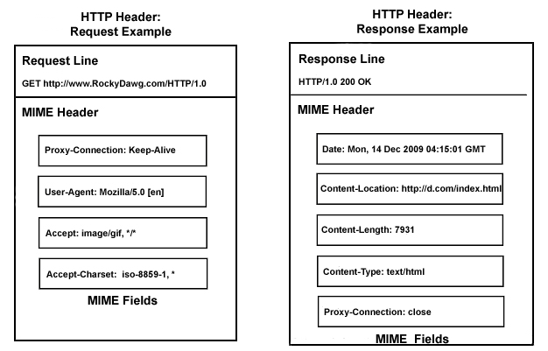
The role of HTTP headers
HTTP headers let the client and the server pass additional information with an HTTP request or response. Request headers contain more information about the resource to be fetched, or about the client requesting the resource.Response headers hold additional information about the response, like its location or about the server providing it.

Slide 8
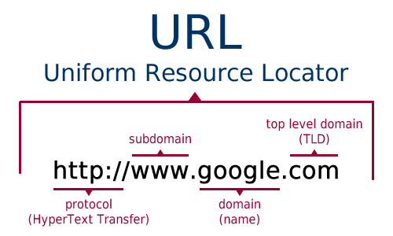
HTTP VS. URL
Both are different term referring different actions or protocols. While The URL is the web address of the particular website, the HTTP is the transfer protocol which connects between the client and the actual resource locator or a server.

Slide 9
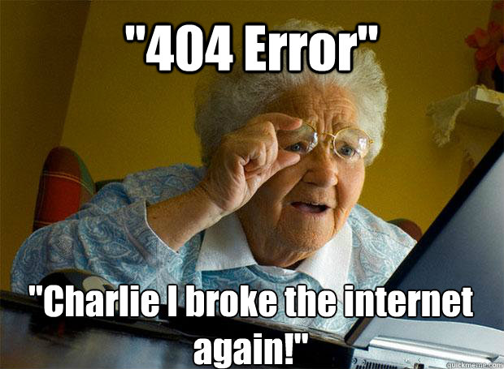
Does a well formulated request imply we get a correct answer?
No. it’s important to understand that even if the request sent by the client held correctly, the server can respond with a failure of different reasons such as: unauthorized client, blocked location (access denied), too many requests, resource not found (404). Sometimes the problem could be in the server itself (code 500)

Slide 10
PRESENTATION A part 2
What types of response codes exist? Define each of them and give an example of use x
Can a server be a client and server? Explain it with an examples x
Where is the code of a web page stored?
What is the difference between a public IP and a private IP?
What is the main functionality of creating subdomains of a main domain?
Explains different uses of using cookies
Difference between sessions and cookies?
How is the port specified when I want to access a certain website (in a protocol that is not the one used by default)

Slide 11
What types of response codes exist? Define each of them and give an example of use
We have the following codes:
1XXX - Informational
Server side acknowledges receiving the headers correctly and awaits for the body from the client side.
A client wants to change the protocols of the server.
2XXX - Success
Confirmation from the server that everything is ok. Server acknowledges access to a website.
3XXX - Redirection
The server has information to redirect requests. Some pages of a website are now inaccessible and lead you to the main page.
4XXX - Client Error
The server warns the client that the request has problems. Wrong information is sent to the server and it cannot be accepted.
5XXX - Server Error
Client receives information that the server is having issues with the request. The server may not have the correct port open.

Slide 12
Can a server be a client and server? Explain it with an examples
Yes a server can be a client and server, the server can host all needs and all calls, but this will not work for an end user.
For example a server of FaceBook can send a request to Google servers or to retrieve info from other servers. The client and the server are always decoupled.

Slide 13
Where is the code of a web page stored?
Servers

Slide 14
What is the difference between a public IP and a private IP?
Public IP
These are public (global) addresses that are used on the Internet. A public IP address is an IP address that is used to access the Internet. Public IP addresses can be routed on the Internet, unlike private addresses.
Private IP
Private (internal) addresses are not routed on the Internet, and no traffic can be sent to them from the Internet; they are only supposed to work within the local network.

Slide 15
What is the main functionality of creating subdomains of a main domain?
Subdomains help organize and navigate through the different sections of a website. This leads to less time waiting for a page request and for the client as well to choose pages on a website faster.

Slide 16
Explains different uses of using cookies
Cookies will save some of your data depending on what the website needs. With this data the website can define what to sell to you, it can answer questions you have already answered before (fill in documentation), it can alter the search patterns on google.

Slide 17
Difference between sessions and cookies?
Sessions are saved server side and that grants the data more security and privacy.
Cookies are saved browser side which grants almost no security and only the privacy you have enabled.

Slide 18
How is the port specified when I want to access a certain website (in a protocol that is not the one used by default)
DNS or DNS resolvers provide the information needed.
Protocols also have very defined ports that can be used.

Slide 19
PRESENTATION B part 1
What are HTTP headers and what are they for?
How can a web browser know that the type of file it receives from a response is of a certain format?
What is the difference between an IP and a MAC address?
What is web hosting?
What’s the difference between website and webpage?
Explain how DNS works when making a request to a url.
What is the difference between IPv4 and IPv6?
What are the parameters of a URL? What are they used for?

Slide 20
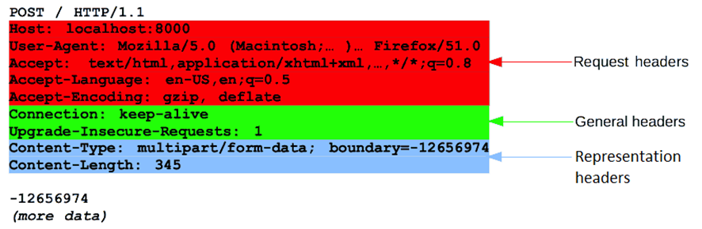
What are HTTP headers and what are they for?
Headers: HTTP requests and responses transmit information about the client's browser, the requested page, the server, etc.

Slide 21
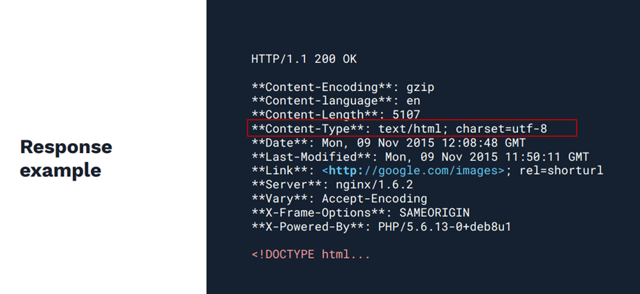
How can a web browser know that the type of file it receives from a response is of a certain format?
Through the HTTP response header we can know what type of file we are receiving

Slide 22
What is the difference between an IP and a MAC address?
The MAC address identifies the network card of a device and cannot vary, it is fixed and is always the same. Meanwhile, the IP address varies, and identifies the device within a specific network, if it is the home one, it is the private IP address, and if it is the Internet, the public IP address.

Slide 23
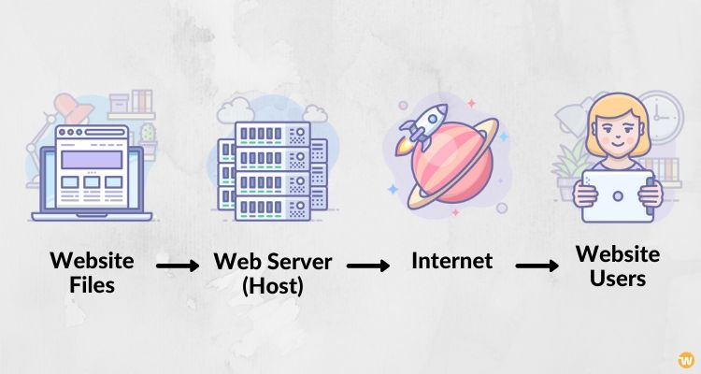
What is web hosting?
A hosting let's say that it is like a server where we can store the files (videos, images, code) and makes our website accessible on the internet.

Slide 24
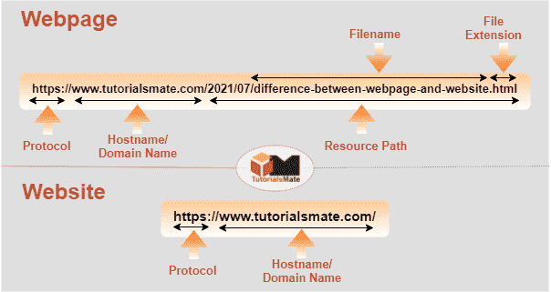
What’s the difference between website and webpage?
Web page let's say that it is the part of a website information / content of a website such as text, images, videos etc.
website refers to the set of web pages

Slide 25
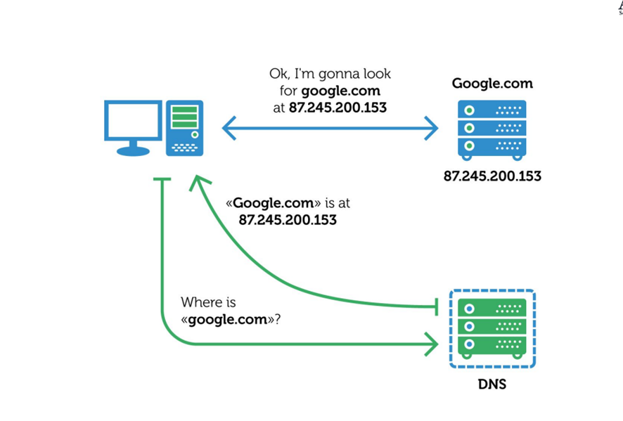
Explain how DNS works when making a request to a url.
Let's say that what the DNS does is that, for example, when the client that would be the user wants to access a web page, it does so through the domain name "Google.com" that has an associated IP address to be able to access, which DNS is translating the domain name you have to an IP address

Slide 26
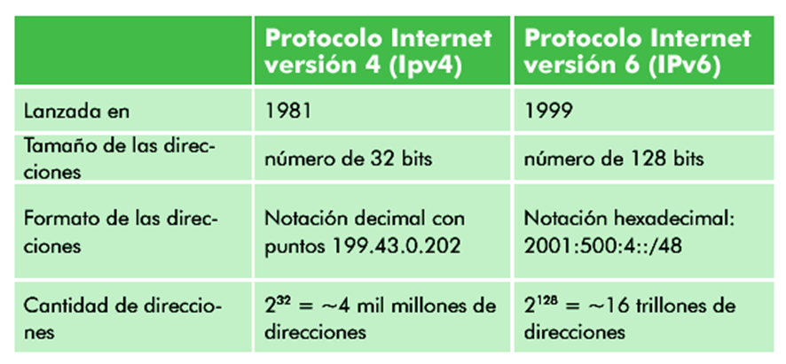
What is the difference between IPv4 and IPv6?

Slide 27
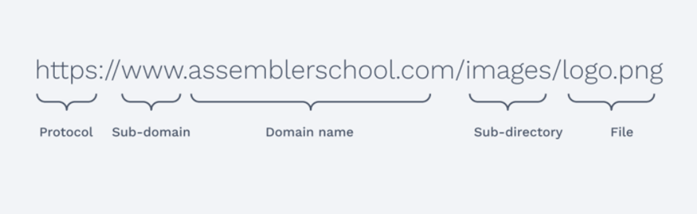
What are the parameters of a URL? What are they used for?
A static website is made up of a series of directories and files located on a server and accessible from your computer through a browser with the URL.

Slide 28
PRESENTATION B part 2
Explain each part of which the URL is made up, such as "https://www.assemblerschool.com"
What is the difference between a client and server?
What is the difference between a permanent redirection and a temporal redirection?
What is the difference between a PATCH and PUT?
What uses does content-length have in responses?
What is the CRUD concept and what are its corresponding methods in the HTTP protocol?
What is the difference between HTTP and HTTPS?
Explain the different versions of HTTP

Slide 29
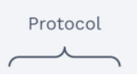
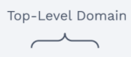
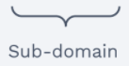
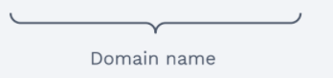
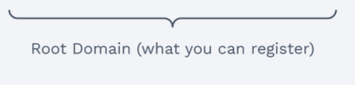
Explain each part of which the URL is made up, such as "https://www.assemblerschool.com"
https://www.assemblerschool.com

Slide 30
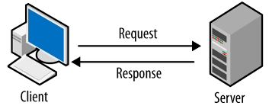
What is the difference between a client and server?
Server:
Running application capable of handling a client’s request and returning a response accordingly
Client:
Computer application or computer that consumes a remote service to the server.

Slide 31
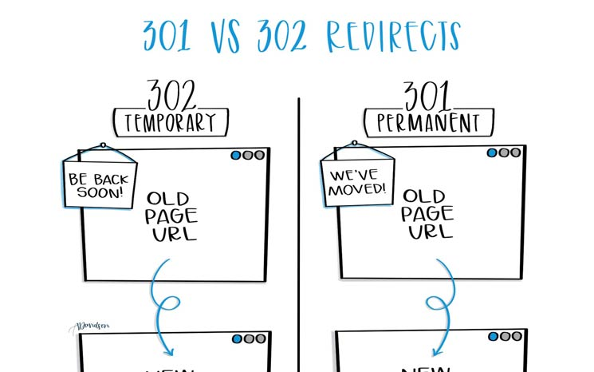
What is the difference between a permanent redirection and a temporal redirection?
302 Temporal redirection
Indicates that the page has moved to a new location, but that it is only temporary.
301 Permanent redirection
Indicates that a page has permanently moved to a new location

Slide 32
What is the difference between a PATCH and PUT?
PUT
Is a method of modifying resource where the client sends data that updates the entire resource.
PUT overwrites the entire entity if it already exists, and creates a new resource if it doesn’t exist.
PATCH
Applies a partial update to the resource.
This means that you are only required to send the data that you want to update, and it won’t affect or change anything else.

Slide 33
What uses does content-length have in responses?
It is a response header send by the server to the client to indicate the size of the message Body, in bytes, sent to the recipient.

Slide 34
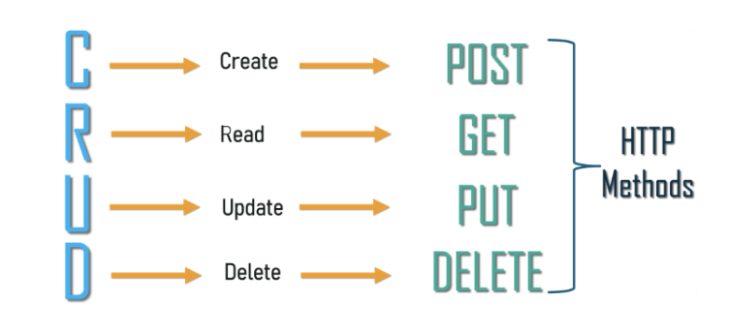
What is the CRUD concept and what are its corresponding methods in the HTTP protocol?
Refers to the four functions that are considered necessary to implement a persistent storage application
CRUD operations are widely used in many applications that are supported by underlying relational databases. These four basic CRUD functions are incredibly versatile in how they can support a variety of important functions across different business models and industry verticals

Slide 35
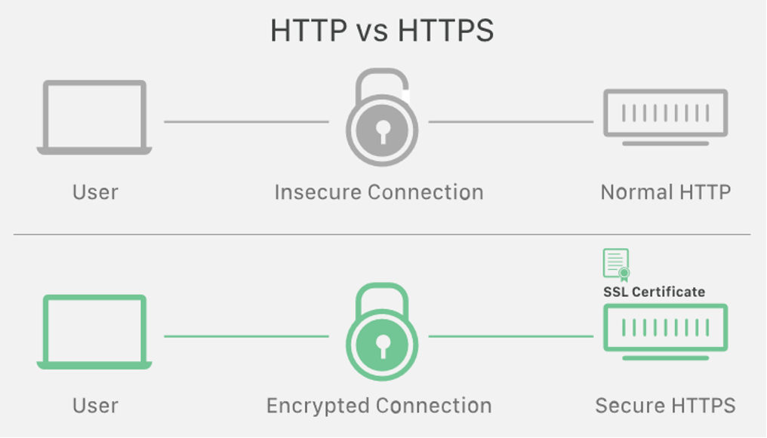
What is the difference between HTTP and HTTPS?
Both allow transferring information on to the world wild web.
HTTPS is an extension of HTTP used for secure communication over a computer network using Transport Layer Security

Slide 36
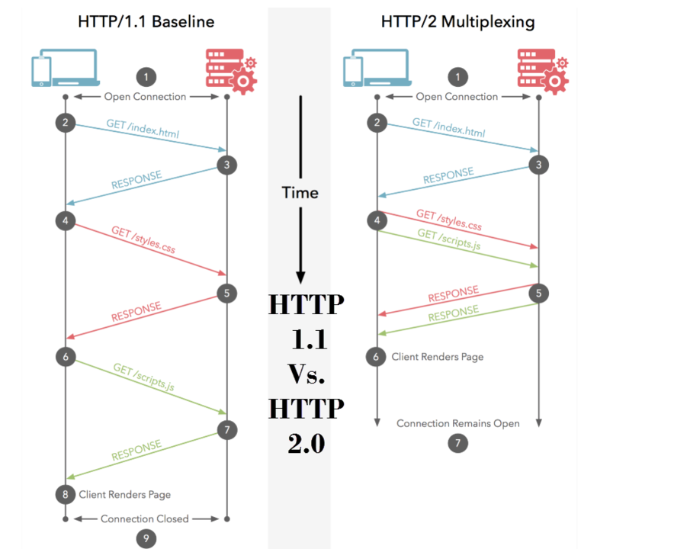
Explain the different versions of HTTP
HTTP/1
Headers allowed in both request and responses, It extended GET to allow Headers.
Adds HEAD request format, and POST request, sends information with the request.
Also Pipelining was added
HTTP 0.9
Extremely simple, requests consisted of a single line and started with the only possible method GET followed by the path to the resource.
HTTP/2
It's a multiplexed protocol. Parallel requests can be made over the same connection,
It allows a server to populate data in a client cache through a mechanism called the server push.
It compresses headers
this removes the duplication and overhead of data transmitted.

Slide 37
Part C Explain the main web concepts using a real-world situation
3. Requirements
You must create a presentation
You will have to explain the history by using key images and concepts from the real world
You must include at least the following concepts:
Server - Warehouse
Request - Medication
Response- Medic
Client
HTTP - Pharmacy
Response codes
Methods - GET (retrieve medication) POST (new medication enter the pharmacy) PUT (update the quantity of the requested medication)
DNS - Pharmacy name
IP - Address
Cookies - DNI
Internet - All pharmacies
A server that also acts as a client - Warehouse contacts it self, contacts other pharmacy for supplies

Slide 38
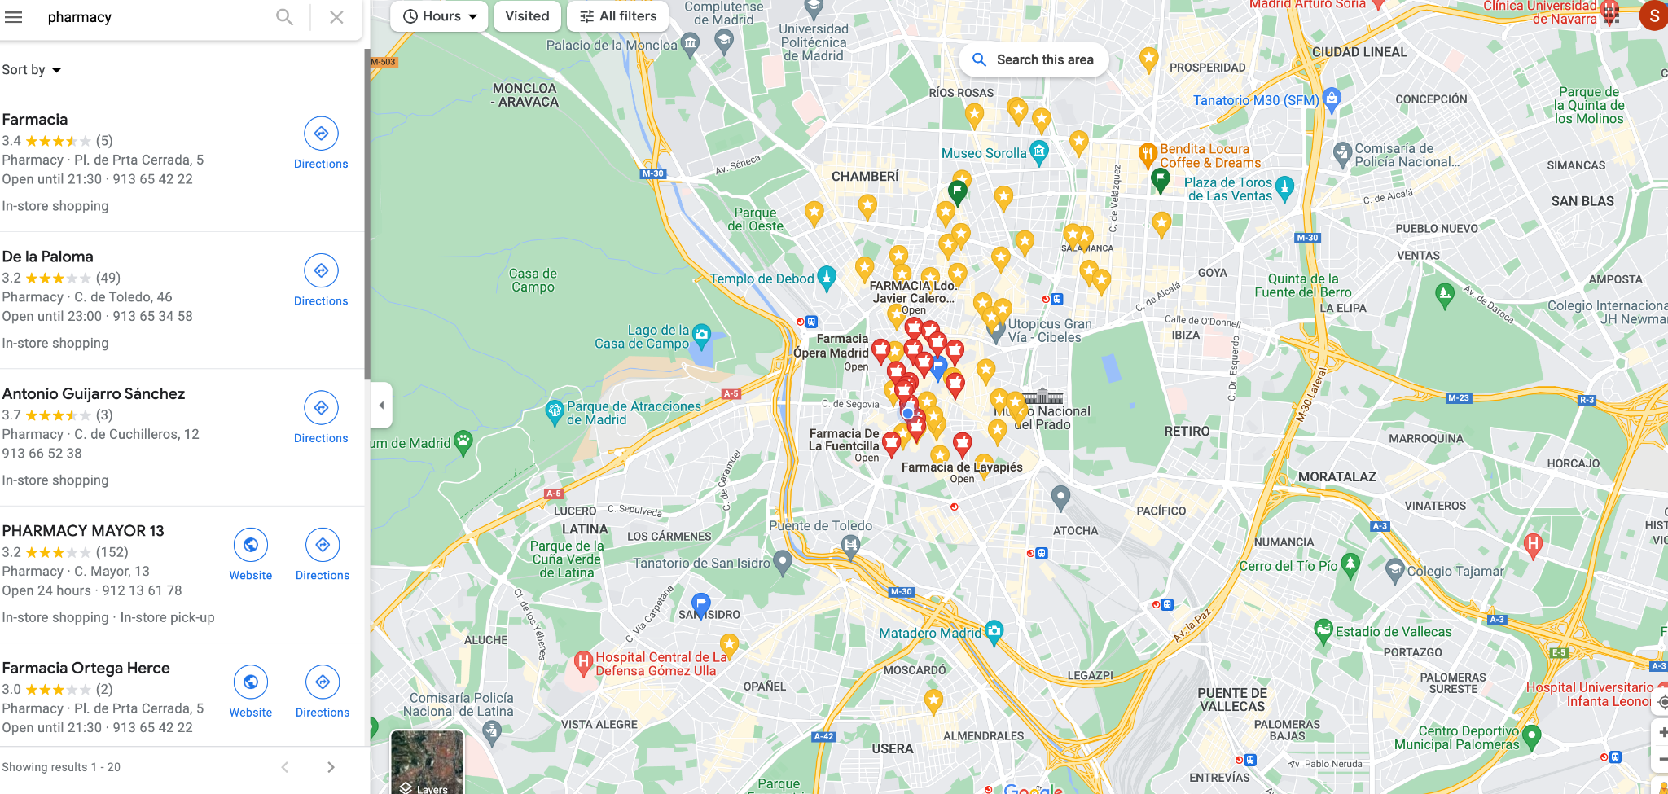
The internet - All pharmacies in the world

Slide 39
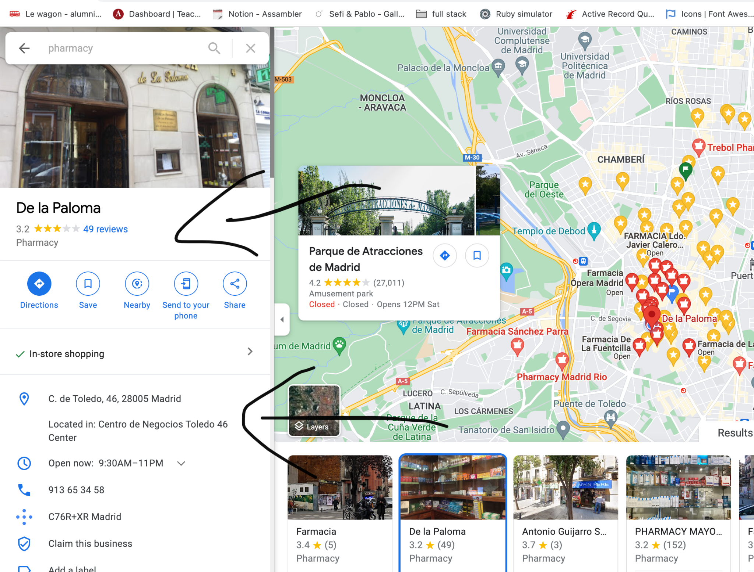
IP address and DNS

Slide 40
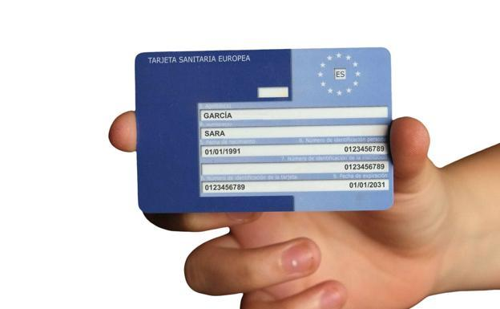

Cookies and requests by clients

Slide 41


Request received by server and GET (medication)

Slide 42


Status 404! Not Found!

Slide 43

Response and PUT(update medication quantity)

Slide 44
Contact other pharmacies for more medication
Server that acts as a client

